Slide 1

Sprocket Central Pty Ltd
Data analytics approach
[Division Name] - [Engagement Manager], [Senior Consultant], [Junior Consultant]

Slide 2
Agenda
Introduction
Data Exploration
Model Development
Interpretation

Slide 3
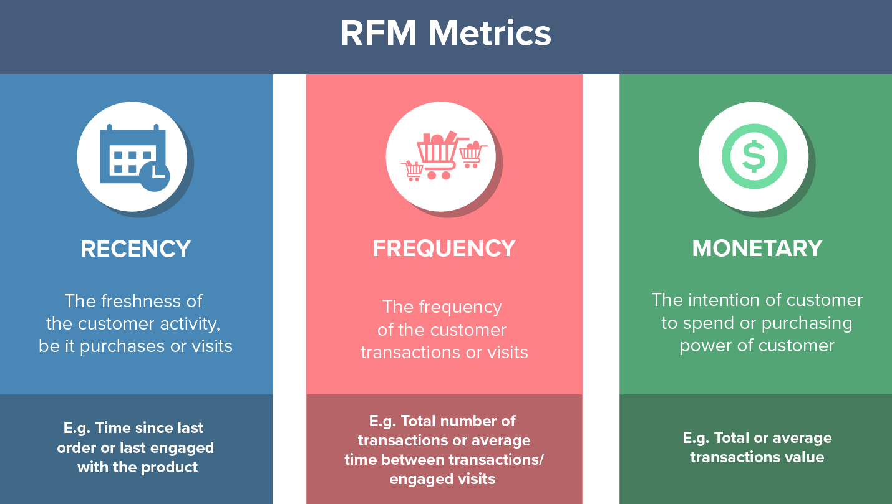
Introduction
RFM Segmentation
RFM segmentation is a long-standing marketing analysis method used to quantitatively group customers based on 3 metrics (recency, frequency and monetary), from
We will be using RFM analysis and machine learning to help you identify your most valuable customers.
Credit: https://clevertap.com/blog/rfm-analysis/

Slide 4
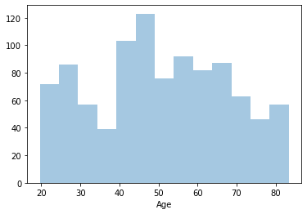
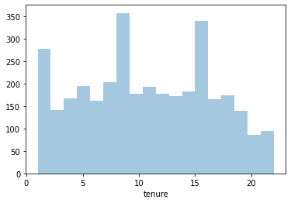
Data Exploration
Light data exploration and cleaning
We begin by separating the data set in to training and test sets. CustomerDemographic and CustomerAddress are merged with Transactions details to form the training set and NewCustomerList will be our test set for identifying the most valuable customers
Continuous numerical features with missing values can be imputed. Age and tenure both have a low number of missing values and generally uniform distributions and can be imputed with the means of both features
Job title and job industry are both missing proportionally large amounts of values that cannot be imputed as they are both categorical. We will not be dropping the rows as this would remove far too much data for training
All customers without transaction details will have to be dropped from the model, as we cannot calculate RFM metrics without them – 508 customers dropped from training set
All issues addressed in our previous email have been resolved via cleaning

Slide 5
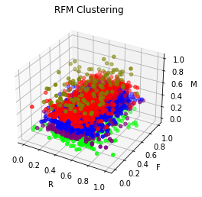
Model Development
Feature Engineering and Clustering
We will be dropping the DOB feature and replacing it with Age for easier modeling
We will be engineering the features recency, frequency and monetary for RFM Analysis. All three features will be scaled 0-1 so to compare different variables on equal footing.
Recency will be the mean of the number of days since the customer’s last purchase
Frequency will be the bike related purchases from the customer in the last 3 years
Monetary will the average profit per customer, calculated by the difference of list price and standard cost under Transactions
We will use k-means clustering to group customers by their RFM metrics. The optimal number of clusters is determined to be 5.
Finally, we will use machine learning (classification) to predict which cluster customers on the NewCustomerList may fall into so you can determine which customers to target

Slide 6
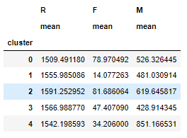
Interpretation
Cluster Details
Cluster 2 can be identified as the most valuable group as it has the highest mean F (highest frequency of purchases) and the second highest mean M (money spent).
Cluster 4 may have the highest mean M but has the second lowest mean F.
Please see submissions.csv for which clusters individual customers belong to

Slide 7
End

